Slide 1
Design and Analysis of Algorithms
CSC 413
LECTURE 4
Topic: Standard Complexity Classes
Lecture Note Presentation

Slide 2
Overview of Complexity Classes
What is a Complexity Class?
  A complexity class is a set of problems grouped together based on the resources (time and space) required to solve them using an algorithm.
    Time complexity → how fast a problem can be solved.
    Space complexity → how much memory is required
The main classes are:
  P (Polynomial Time)
  NP (Non-deterministic Polynomial Time)
  NP-Complete
  NP-Hard

Slide 3
Class P (Polynomial Time)
🔹 Definition: P = The class of decision problems (yes/no problems) that can be solved by a deterministic algorithm in polynomial time.
Formally: A problem is in P if there exists an algorithm that solves it in O(n^{k}) time, for some constant k.
Example:
These problems are efficiently solvable and verifiable in polynomial time.
Problem | Description | Time Complexity
Sorting | Arrange numbers | O(n log n)
Searching | Binary search in a sorted array | O(log n)
Shortest Path | Dijkstra’s algorithm | O(V²)

Slide 4
Class NP (Nondeterministic Polynomial Time)
Definition:
  NP = The class of decision problems where a given solution can be verified in polynomial time by a deterministic algorithm.
  the class of decision problems that are solvable in polynomial time on a nondeterministic machine (or with a nondeterministic algorithm)
The “N” stands for nondeterministic — a hypothetical model where guesses can be made instantly.
Features:
  The solutions of the NP class might be hard to find since they are being solved by a non-deterministic machine but the solutions are easy to verify
  Problems of NP can be verified by a deterministic machine in polynomial time.
Example:
  Hamiltonian Cycle Problem – Given a graph, does there exist a cycle visiting every vertex exactly once?
    Hard to find (no known polynomial algorithm)
    Easy to verify a proposed cycle in O(n) tim
Thus, P ⊆ NP, since every problem solvable in polynomial time is also verifiable in polynomial time.

Slide 5
Reduction
A lot of times you can solve a problem by reducing it to a different problem. I can reduce Problem B to Problem A if, given a solution to Problem A, I can easily construct a solution to Problem B. (In this case, "easily" means "in polynomial time.“).
A problem R can be reduced to another problem Q if any instance of R can be rephrased to an instance of Q, the solution to which provides a solution to the instance of R – This rephrasing is called a transformation
Intuitively: If R reduces in polynomial time to Q, R is “no harder to solve” than Q
Example: lcm(m, n) = m * n / gcd(m, n), lcm(m,n) problem is reduced to gcd(m, n) problem

Slide 6
Class NP-Hard Problems
A problem is NP-Hard if every problem in NP can be reduced to it in polynomial time,
but the NP-Hard problem itself does not have to belong to NP.
  Implications:
    NP-Hard problems are at least as hard as the hardest problems in NP.
    They may not be decision problems (i.e., problems with “yes/no” answers).
    They may not be verifiable in polynomial time — because verification only applies to decision
Features:
  All NP-hard problems are not in NP.
  It takes a long time to check them. This means if a solution for an NP-hard problem is given then it takes a long time to check whether it is right or not.
  A problem A is in NP-hard if, for every problem L in NP, there exists a polynomial-time reduction from L to A.

Slide 7
Class NP-Complete Problems
A problem is NP-complete if the problem is both – NP-hard, and – NP.
Common NP-Complete problems:
Problem | Description
Traveling Salesman Problem (TSP) | Find the shortest route visiting each city once and returning to the start.
Knapsack Problem | Choose items to maximize value without exceeding weight limit.
3-SAT (Boolean Satisfiability) | Determine if a Boolean formula can be satisfied.
Graph Coloring | Can we color a graph with k colors so that no adjacent nodes share a color?
Subset Sum | Is there a subset of numbers that sums to a given value?

Slide 8
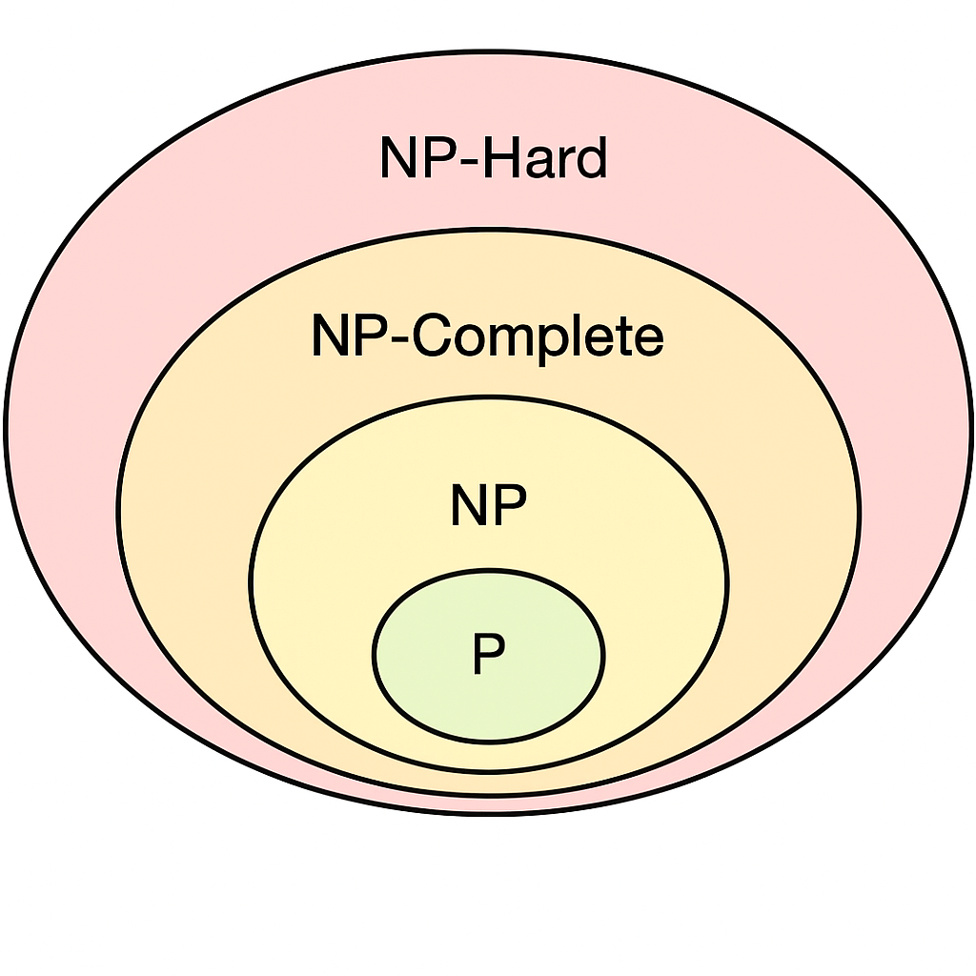
Relationship among Standard Complexity classes
Class | Solvable in Polynomial Time? | Verifiable in Polynomial Time?
P | ✅ Yes | ✅ Yes
NP | ❌ Unknown | ✅ Yes
NP-Complete | ❌ Unknown | ✅ Yes
NP-Hard | ❌ No | ❌ Not necessarily
NP-Hard ⊇ NP-Complete ⊇ NP ⊇ P

